Slide 1


Slide 2

INTRODUCTION
This project is based on the analysis of a Olympics games database using MS SQL SERVER.
The aim of this analysis was to extract valuable insights and answer a variety of questions related to the history, participation, and performance of nations and athletes in the Olympic Games.
I have extracted two .csv
Aggregated the data by using GROUP BY, JOINS, Sub Queries and Windows Function to generate valuable insights from participants data.
Implemented advanced functions such as CASE, PIVOT and CTE to showcase trends and performance of players which helps in fetching valuable information.

Slide 3
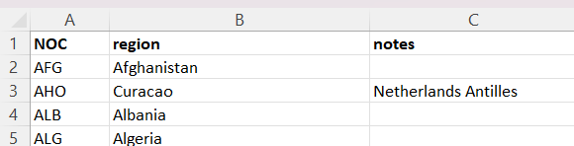
TABLES
‘athlete_events’ – This table contains the data of all athletes that are participating in all types of games with other various information.
This the is main table which contains 2,71,117 rows in total.
The following image is a glimpse of the athlete table.
‘noc_region’ – This table contains the data of different NOC (National Olympic Committee) and their respective regions following with a note column.
The following image is a glimpse of the NOC table.

Slide 4
DATA VALIDATION
‘athlete_events’ – Renamed a column named ‘Year’ into ‘Year’ as Year is a built in keyword in SQL SERVER.
-- Rename the "Year" column to "Years"
EXEC sp_rename '[dbo].[athlete_event].[Year]', 'Years', 'COLUMN'
‘noc_region’ – Updated Singapore NOC to match the value with ‘athlete_events’ table’s NOC.
-- Updating 'SIN' to 'SGP' in noc_regions table as 'Singapore' NOC is 'SGP' in athlete_event table.
update noc_regions
set NOC = 'SGP'
where NOC = 'SIN'

Slide 5


QUERY 1
Q. How many Olympics games have been held?
Provides historical context and understanding of the scale of the Olympics, helping stakeholders appreciate the rich tradition of the event.

Slide 6

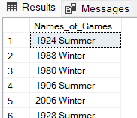
QUERY 2
Q. List down all Olympics games held so far.
Offers a comprehensive list of all Olympic games, aiding historians, researchers, and enthusiasts in studying the history of the Olympics.

Slide 7
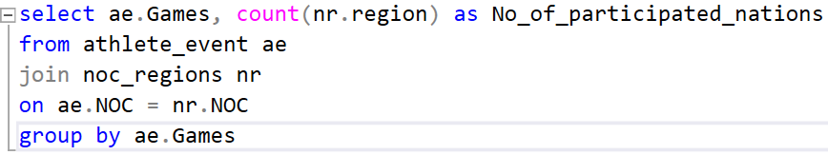
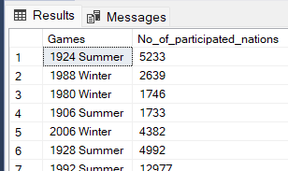
QUERY 3
Q. Mention the total number of nations who participated in each Olympics game.
Helps in evaluating the growth and inclusivity of the Olympics, providing insights into the global nature of the event.

Slide 8
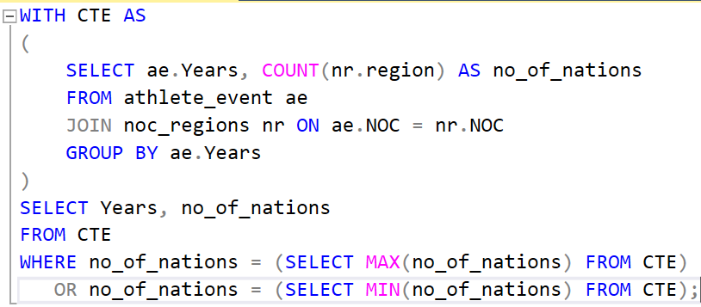
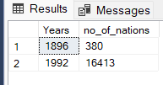
QUERY 4
Q. Which year saw the highest and lowest number of countries participating in Olympics?
Offers insights into historical trends, which can be useful for event organizers and policymakers to assess the impact of changes in participation rules.

Slide 9
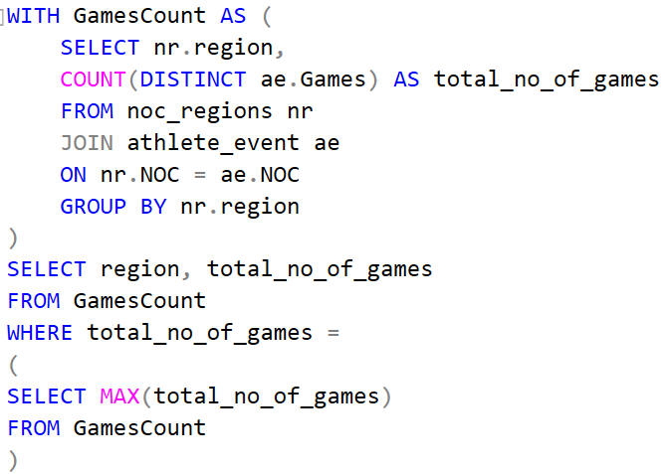
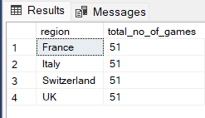
QUERY 5
Q. Which nation has participated in all of the Olympic games?
Demonstrates a remarkable feat, highlighting a country's long-term commitment to the Olympics and promoting national pride.

Slide 10
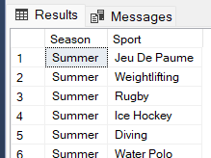
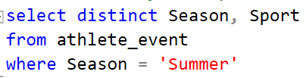
QUERY 6
Q. Identify the sport played in all summer Olympics.
Offers valuable data for sports enthusiasts and sponsors to understand the consistent appeal of a particular sport.

Slide 11
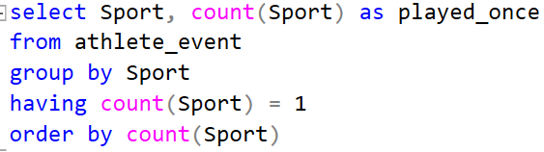

QUERY 7
Q. Which sports were played only once in the Olympics?
Provides information for event organizers to consider the diversity of sports and evaluate the historical popularity of various events.

Slide 12
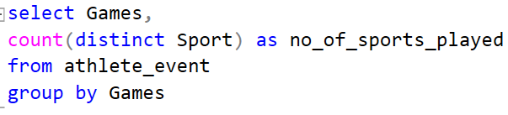
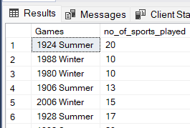
QUERY 8
Q. Fetch the total number of sports played in each Olympic game.
Offers insights into the evolution of the Olympic program, helping stakeholders understand how it has adapted to changing sports interests.

Slide 13
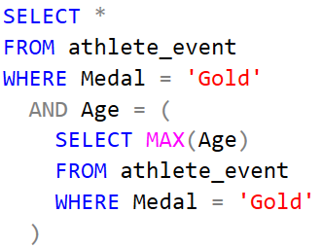
QUERY 9
Q. Fetch details of the oldest athletes to win a gold medal.
Inspires athletes and sports enthusiasts by showcasing stories of longevity and perseverance in sports.

Slide 14
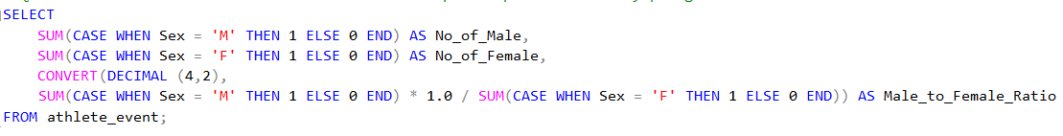

QUERY 10
Q. Find the ratio of male and female athletes participating in all Olympic games.
Highlights gender diversity and can guide future initiatives to ensure gender equity in sports.

Slide 15
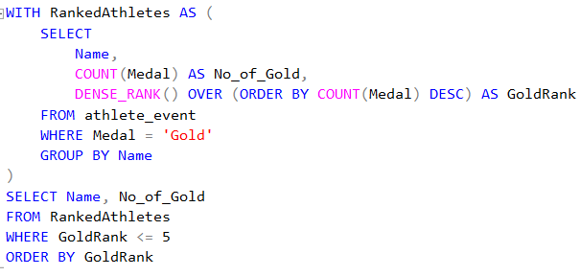
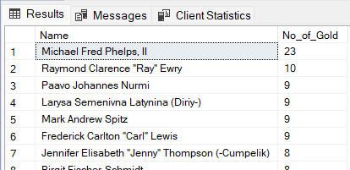
QUERY 11
Q. Fetch the top 5 athletes who have won the most gold medals.
Recognizes sporting legends and offers inspiration for athletes aiming for excellence.

Slide 16
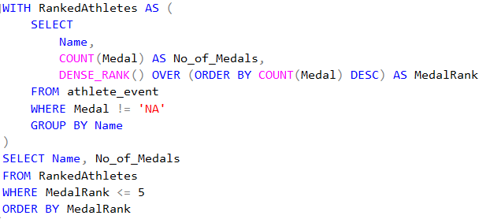
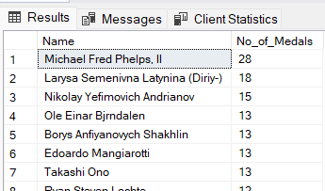
QUERY 12
Q. Fetch the top 5 athletes who have won the most medals (gold/silver/bronze).
Celebrates versatile athletes and offers benchmarks for aspiring competitors.

Slide 17
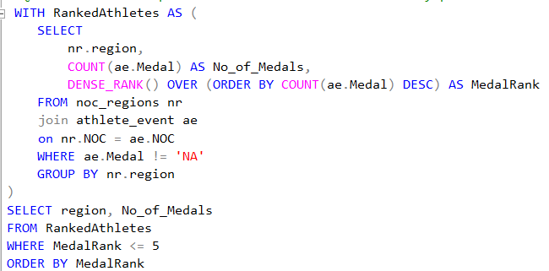
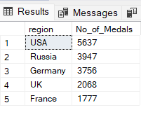
QUERY 13
Q. Fetch the top 5 most successful countries in the Olympics based on the number of medals won.
Promotes national pride and can influence investment in sports development at the national level.

Slide 18
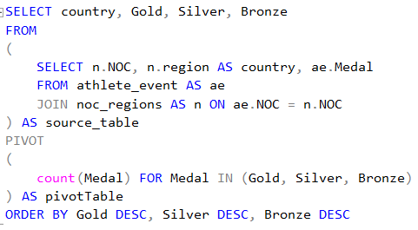
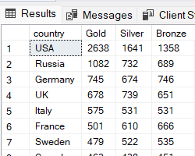
QUERY 14
Q. List down total gold, silver, and bronze medals won by each country.
Provides a comprehensive overview of a country's historical performance in the Olympics, aiding in strategic planning and resource allocation.

Slide 19
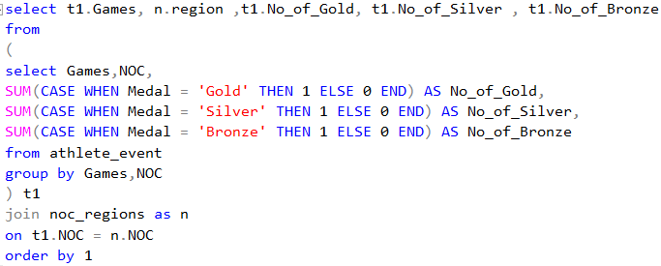
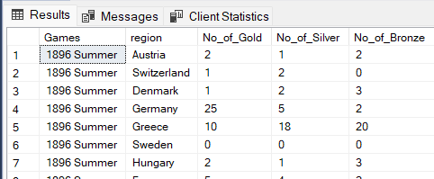
QUERY 15
Q. List down total gold, silver, and bronze medals won by each country corresponding to each Olympic game.
Offers detailed insights into historical trends and allows countries to evaluate their performance over time.

Slide 20
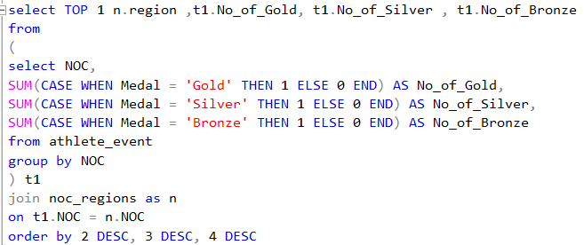

QUERY 16
Q. Identify which country won the most gold, most silver, and most bronze medals in each Olympic game.
Recognizes dominant countries in each event, influencing national sports policies and investments.

Slide 21
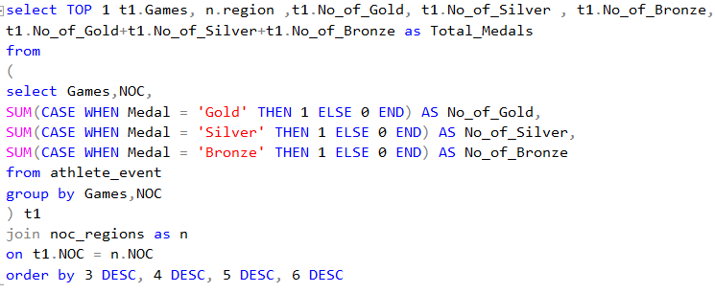

QUERY 17
Q. Identify which country won the most gold, most silver, most bronze medals, and the most medals in each Olympic game.
Offers a comprehensive view of overall performance, serving as a source of national pride and guidance for future strategies.

Slide 22
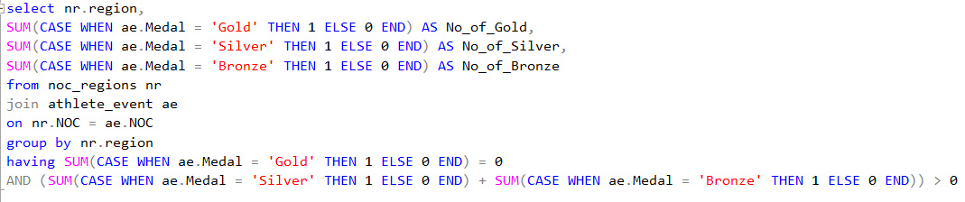
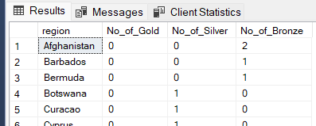
QUERY 18
Q. Which countries have never won gold medals but have won silver/bronze medals?
Celebrates countries that have achieved success in specific sports and motivates them to strive for gold medals.

Slide 23
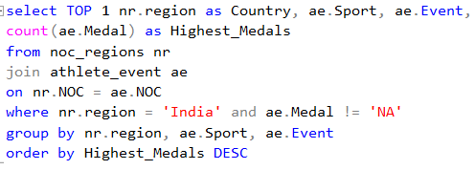

QUERY 19
Q. In which sport/event, India has won the highest number of medals.
Provides insights for Indian sports associations and policymakers to focus on sports with proven success.

Slide 24
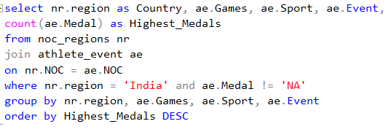
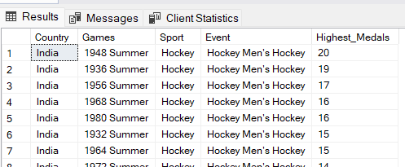
QUERY 20
Q. Break down all Olympic games where India won medals for Hockey and the number of medals in each Olympic game.
Offers a historical perspective on India's achievements in a popular sport, serving as an inspiration for hockey enthusiasts and policymakers.

Slide 25
THE END
Project By – Udipta Anupam
Email - udiptaanupam@gmail.com
LinkedIn - www.linkedin.com/in/udipta-anupam
Github - https://github.com/udipta14

